Slide 1
DEVELOPED, MANUFACTURED and COMMERCIALIZED

Slide 2






DE-SEIZE
PENETRATING OIL
CLEAN
LUBRICATE
ASSEMBLE
PROTECT

Slide 3




INTRODUCTION

Slide 4
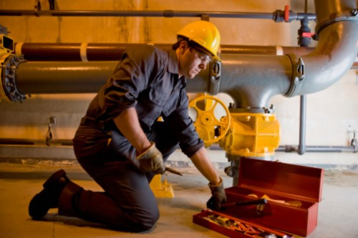
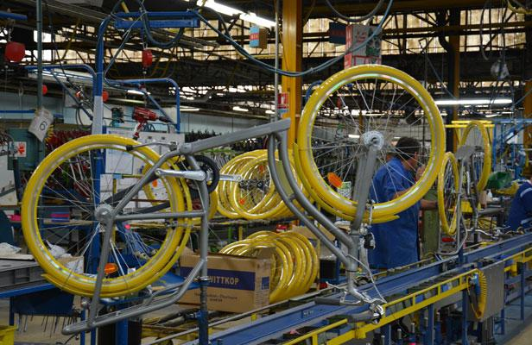
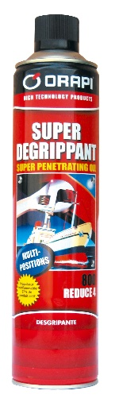
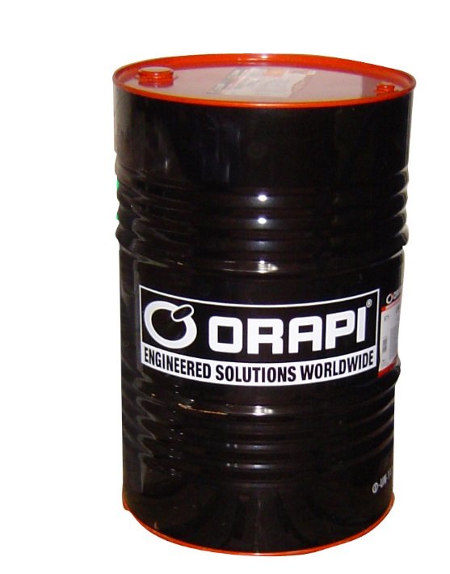
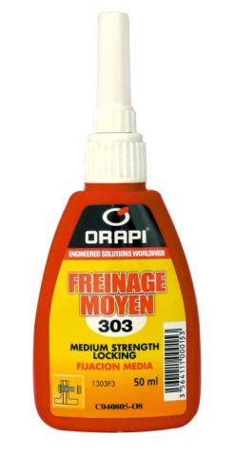
PROCESS is our TARGET
maintenance
process

Slide 5
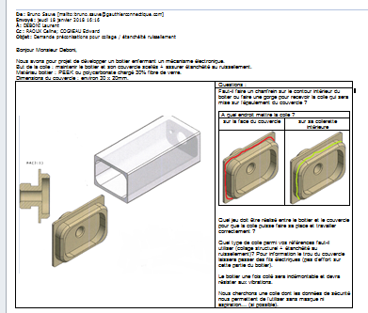
PROCESS is our TARGET
ORABOND 125
50 000 boxes
5 g / boxes
about 650 cartridges

Slide 6
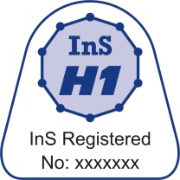
LES AGREMENTS
NAVY
Automobile
FOOD industries
GAS
FRENCH ARMY - NATO
SNCF - RAILS
Aéronautic
EDF
French nuclear industries

Slide 7
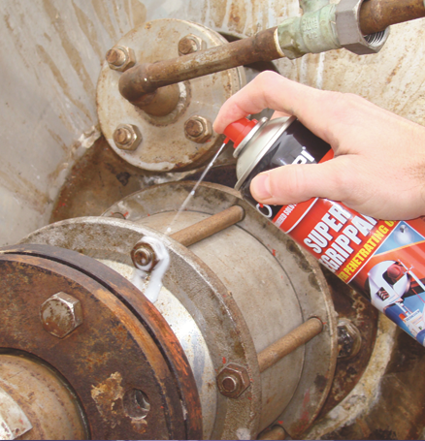
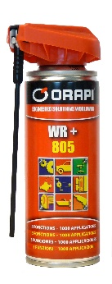
DE-SEIZE – PENETRATING OIL
1
EFFICACITY
REDUCE 4
MULTI PURPOSE
WR +
FOOD INDUSTRIES
ODORLESS COLORLESS
REDUCE AL

Slide 8
CLEANERS
2
SOLVENTS
(pétrolier / végétal)
PH
ALKALINES
ACIDS
DETERGENTS
(WATER BASED)
FLASH POINT
IKB
VOC
EMULSIFIABLE
TRADITIONNAL

Slide 9
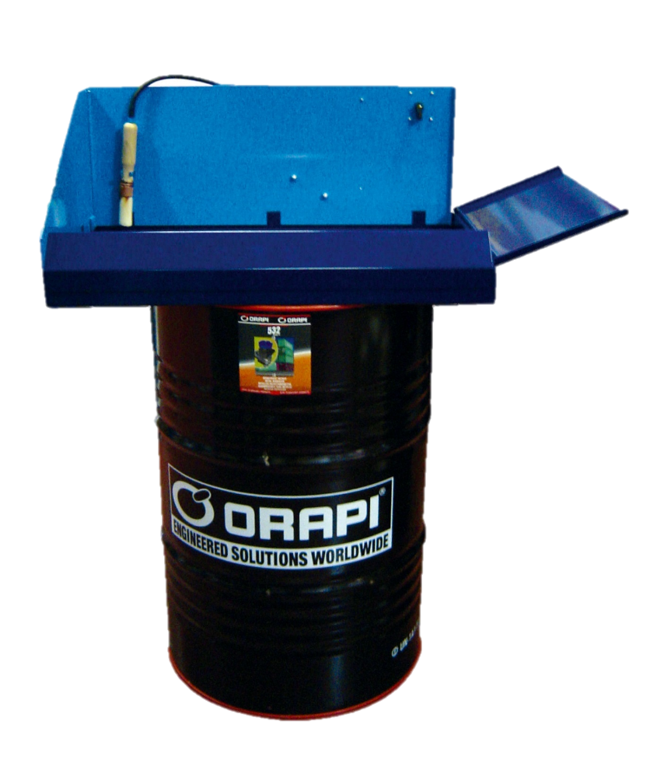
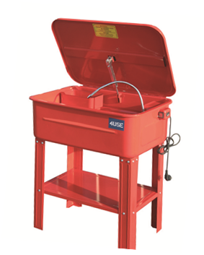
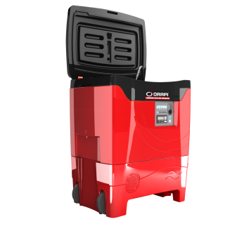
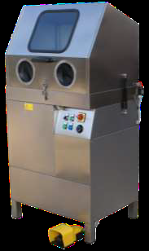
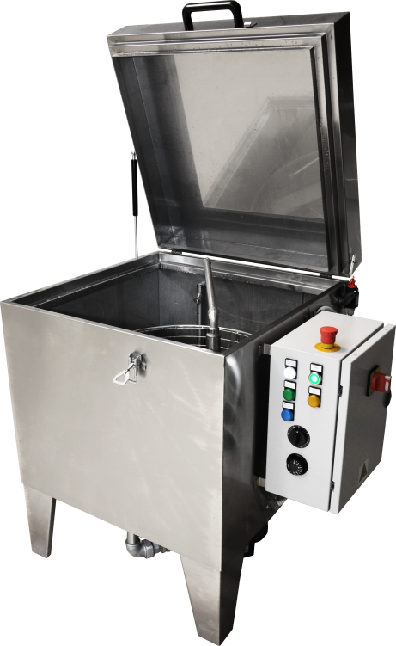
PART WASHERS
2
200 liters
DETERGENTS
BIO OWASHER
SOLVENTS
MAL
HP
40 liters

Slide 10


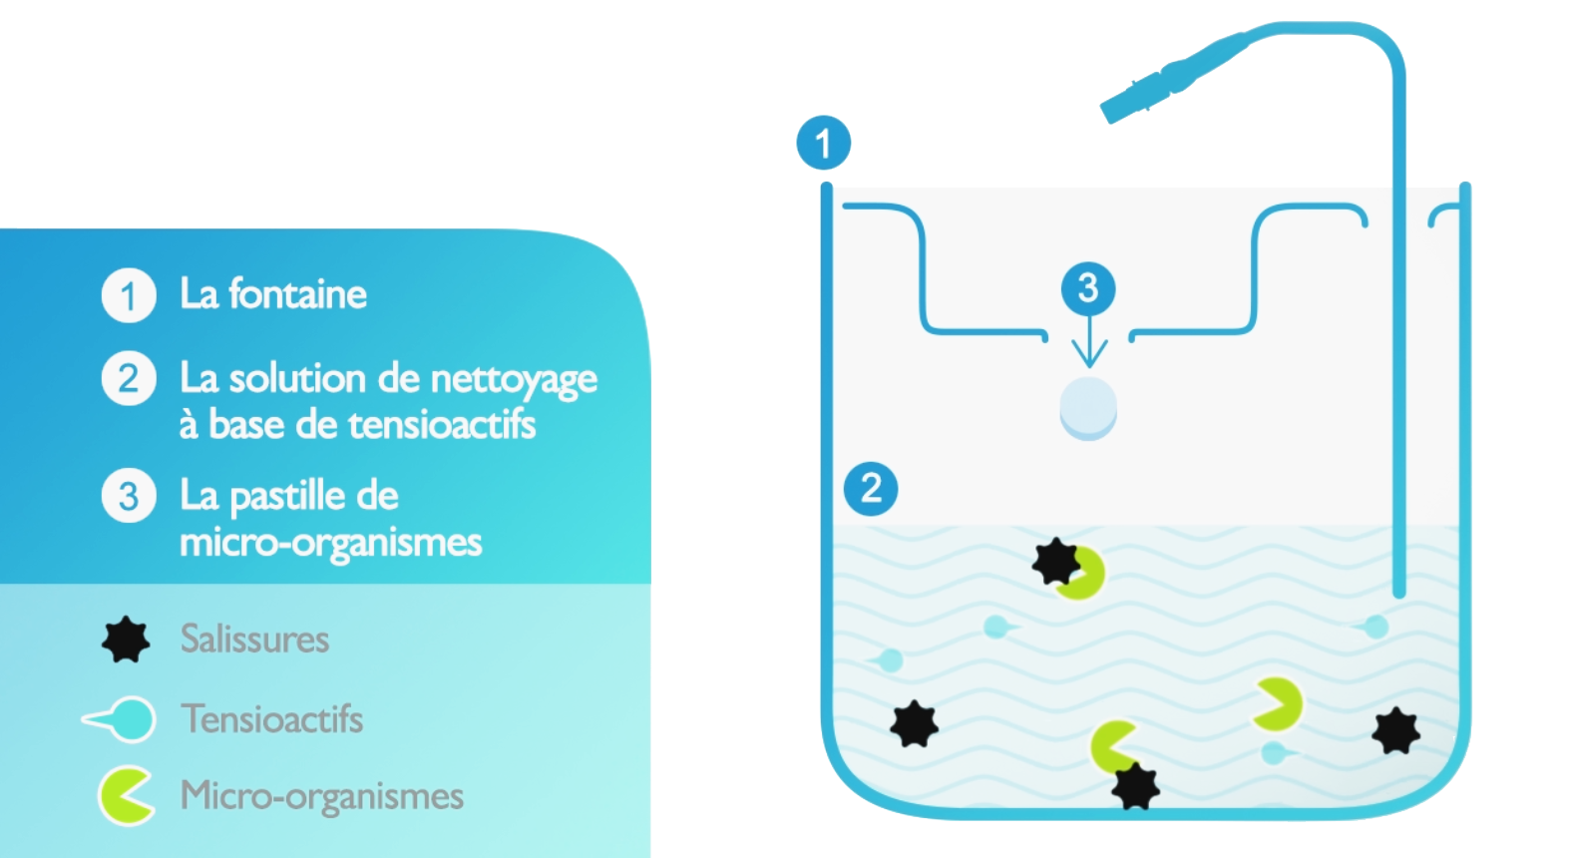
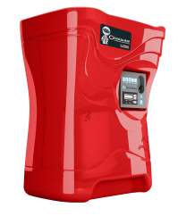

2
OWASHER part washer
It works at 38°C
DETERGENT
ORANET F
Special formulation
Without VOC
Non flammable
Non toxic
Micro-organisms tablets
ORAZYM
It clean the detergent to increase the self life of the bath.

Slide 11
PART WASHERS
2
ORANET S+ 533
Non foaming
ORANET M 532
Spécial métallic parts

Slide 12
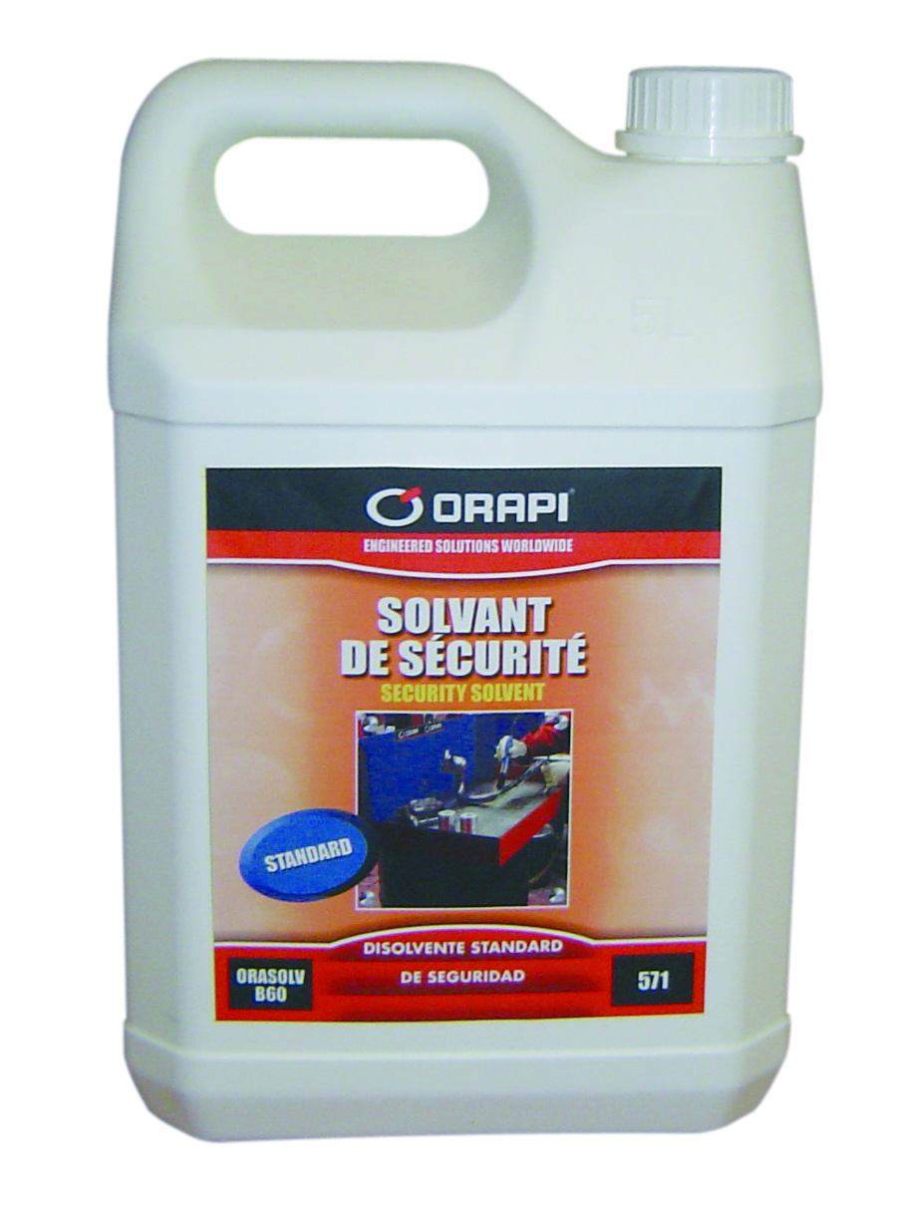
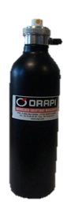
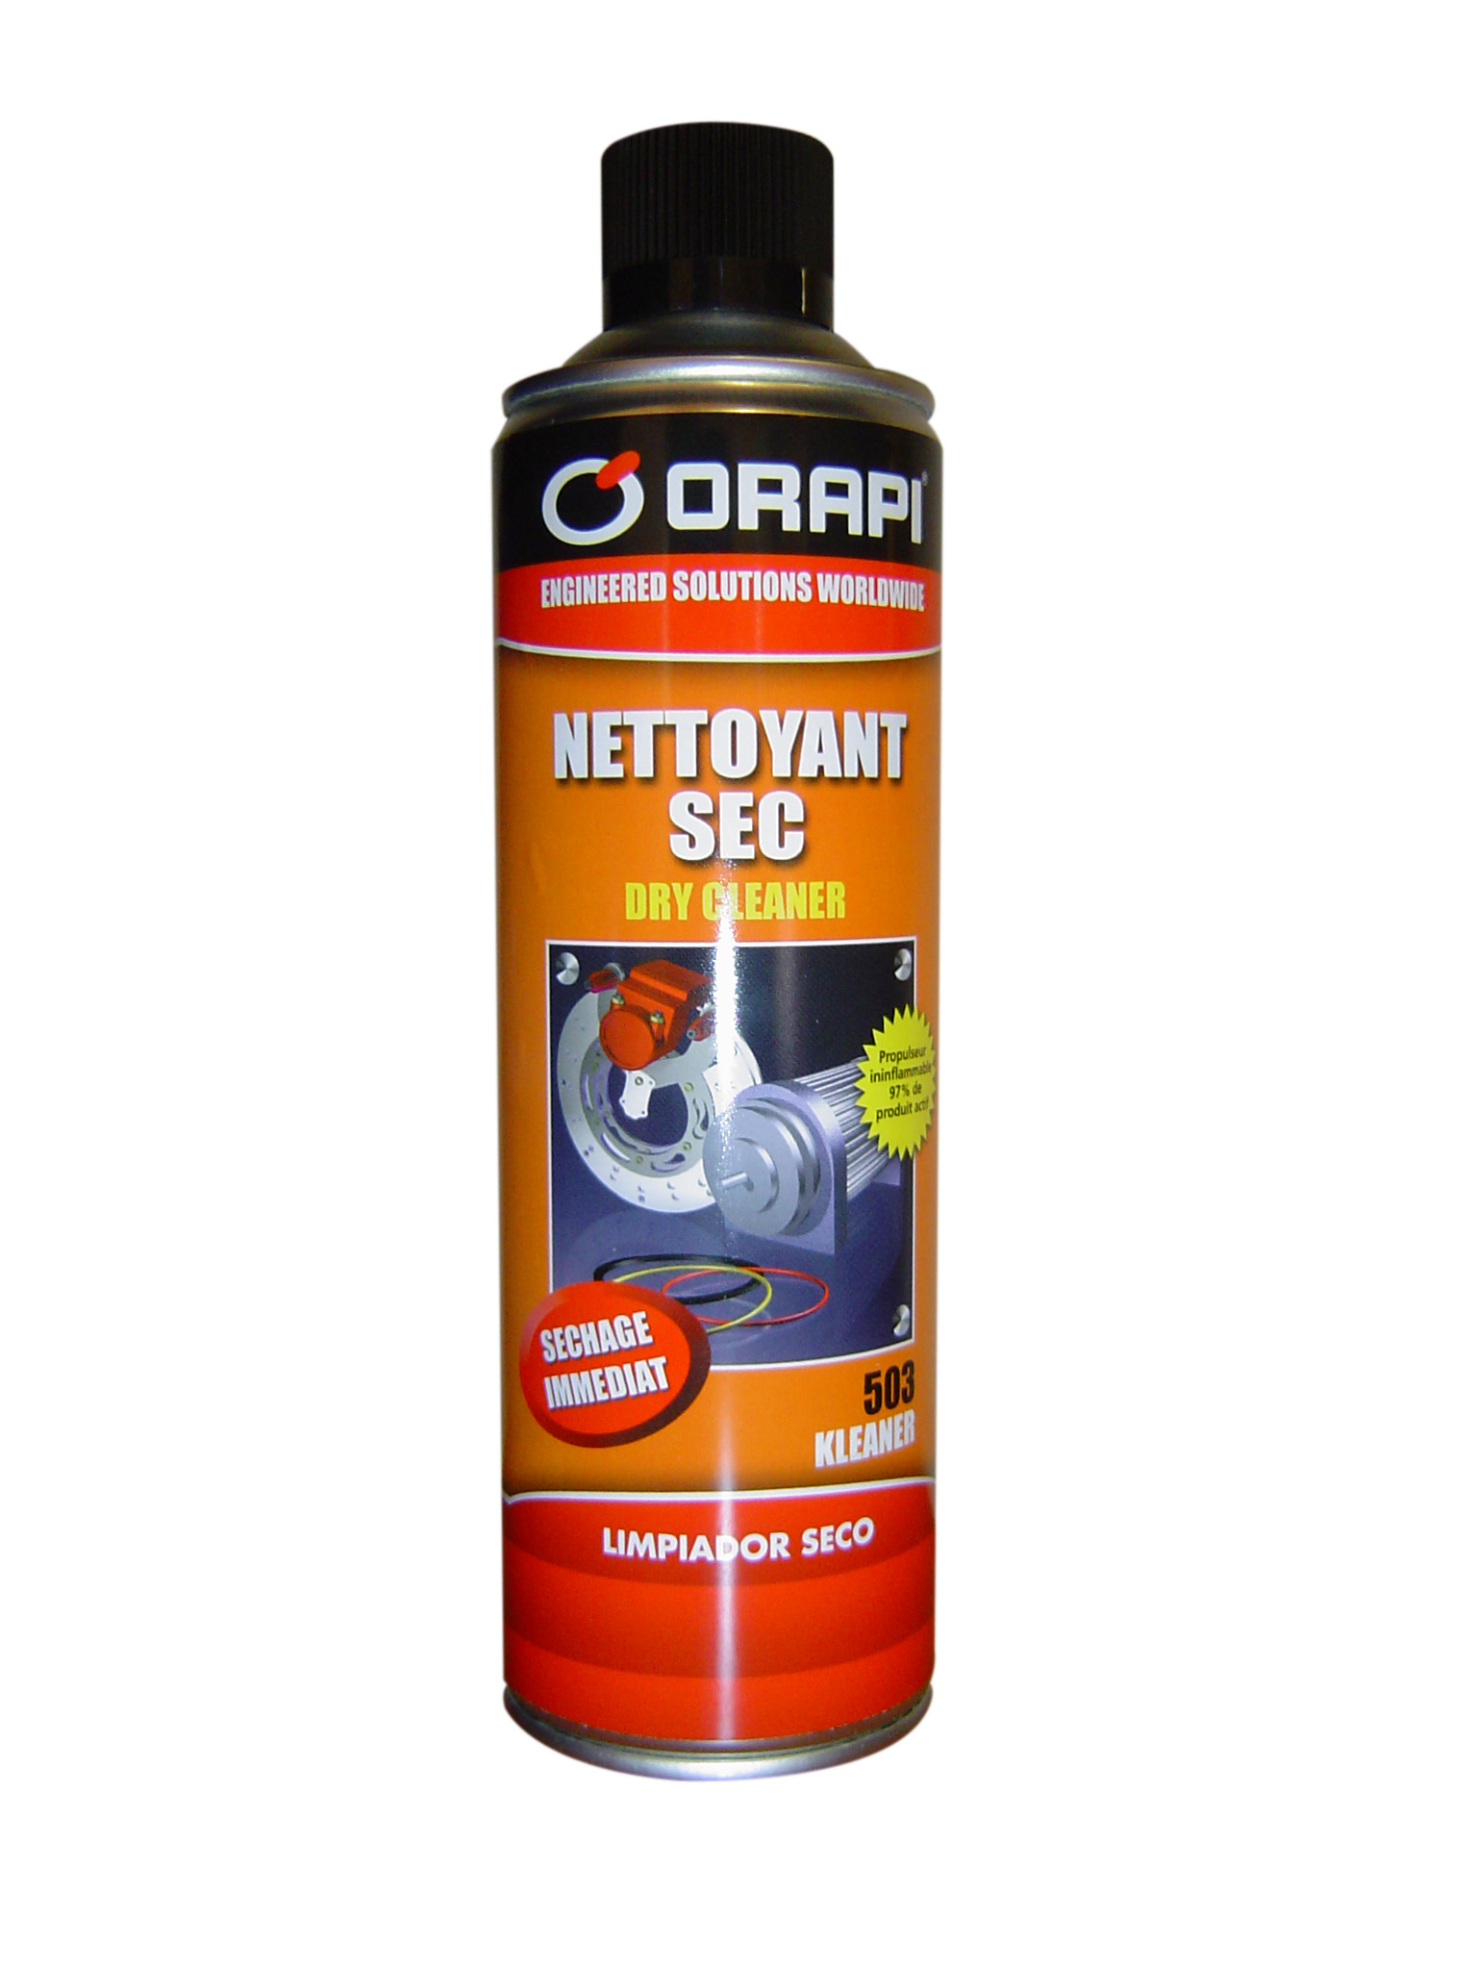
RE FILLED SPRAY CAN
2
MUST BE USED WITH SOLVENT IN JERRYCAN
REDUCE
ECONOMIC
EASY TO USED

Slide 13
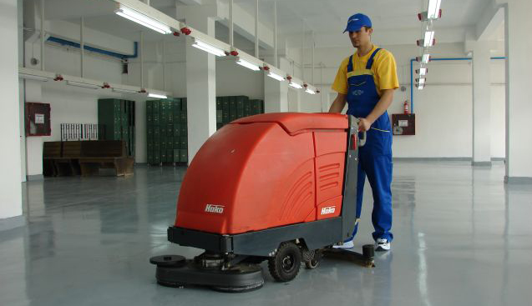
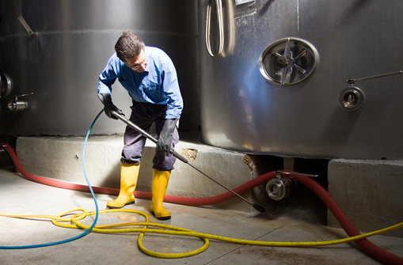
WATER BASED – BEST SELLERS
2
ALKALINE
FOR OILS and GREASES
ORANET B1
ACID for RUST and CONCRETE
ORARENOV
PHOSPHATATION
ORAPHOS 50 et 60

Slide 14
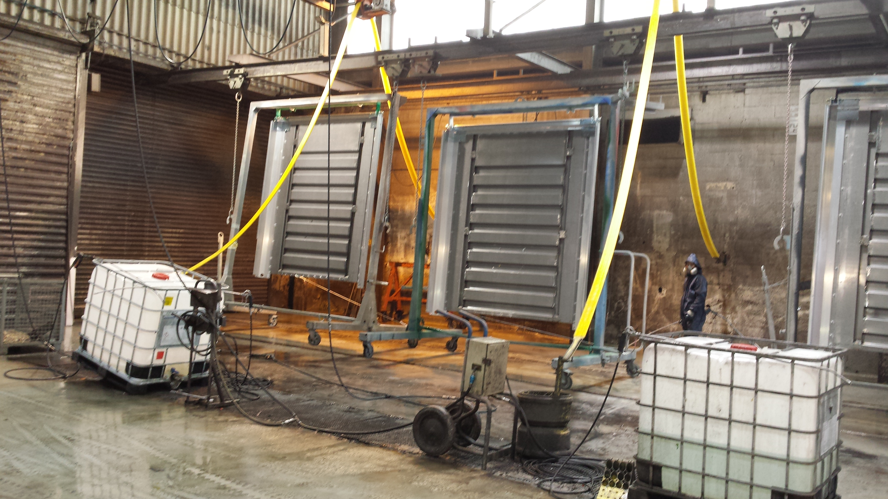
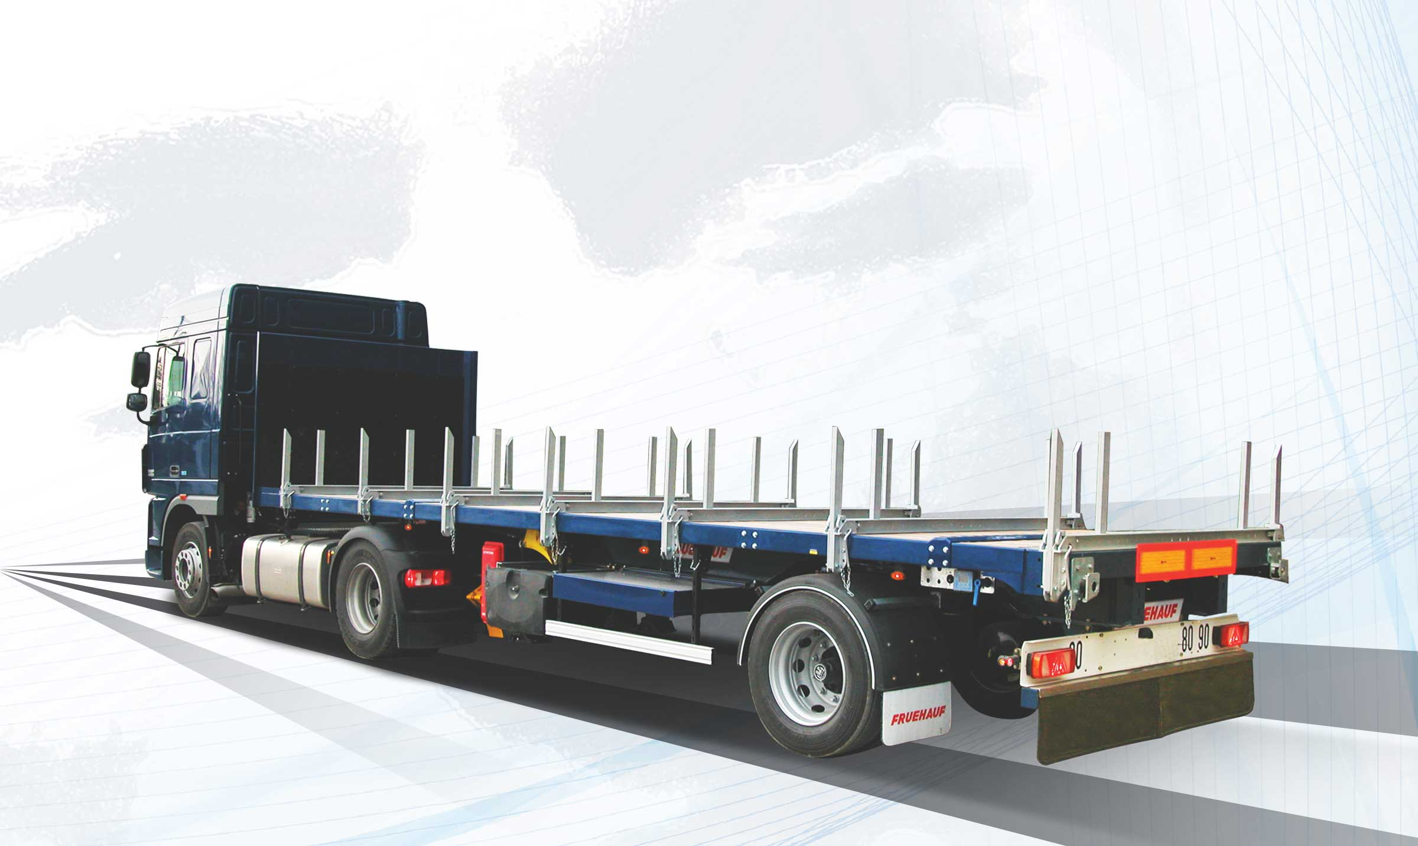
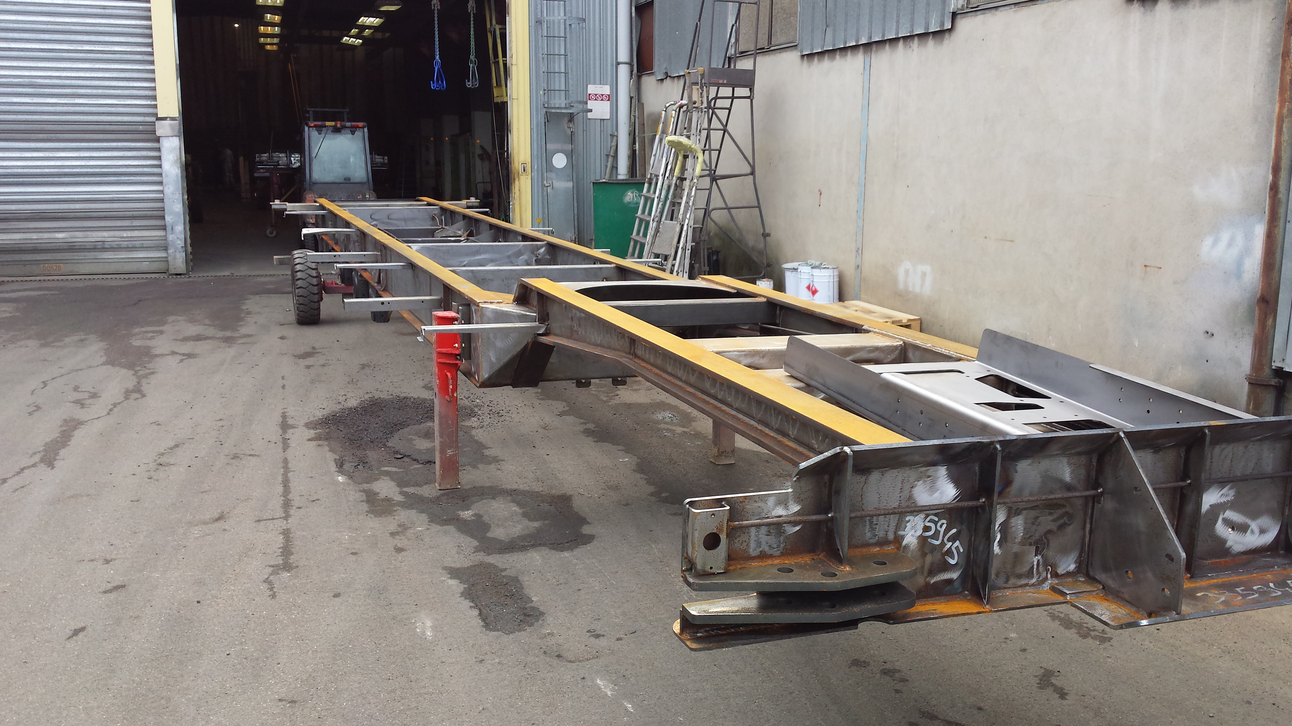
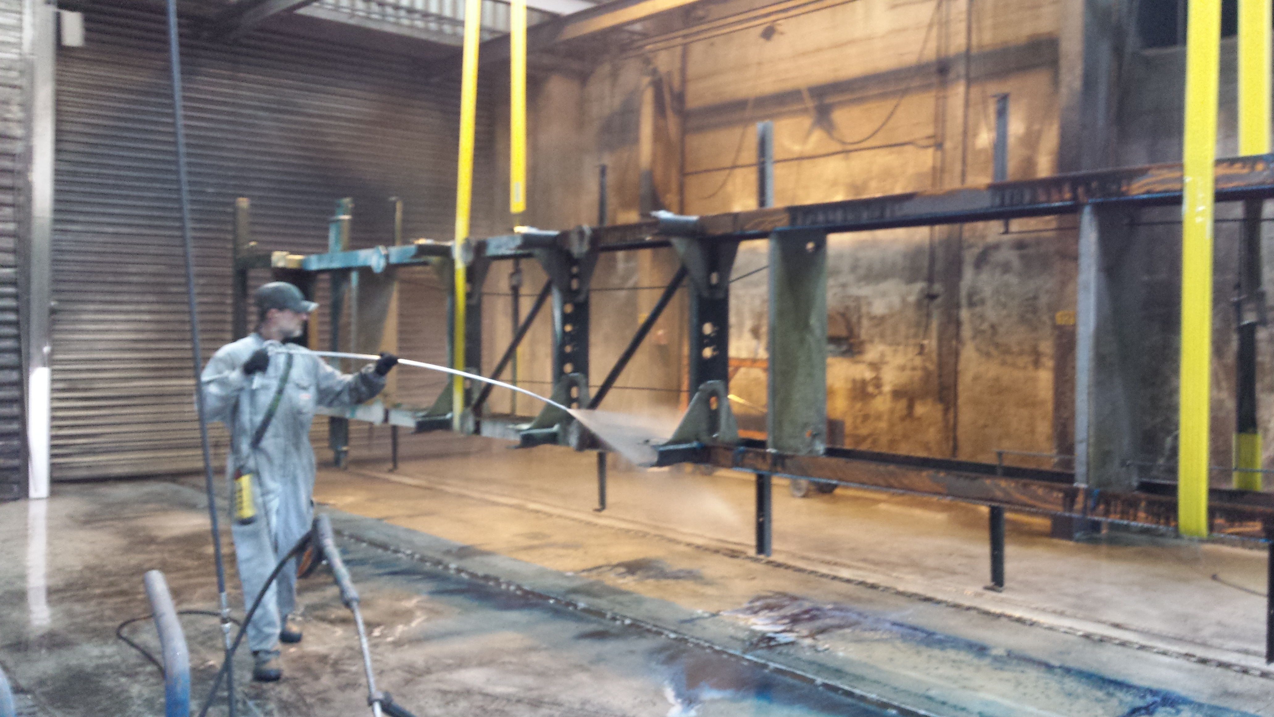
EXAMPLE FRUEHAUF
2
ORAPHOS 50: DEGREASE and PHOSPHATE
ORAPHOS 60: RUST REMOVER and PHOSPHATE
880 LITERS / day !

Slide 15
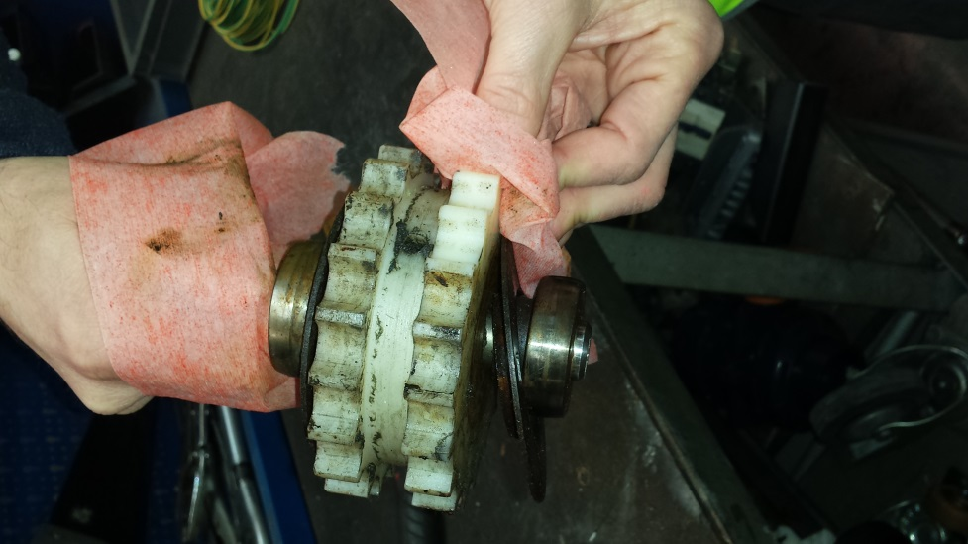
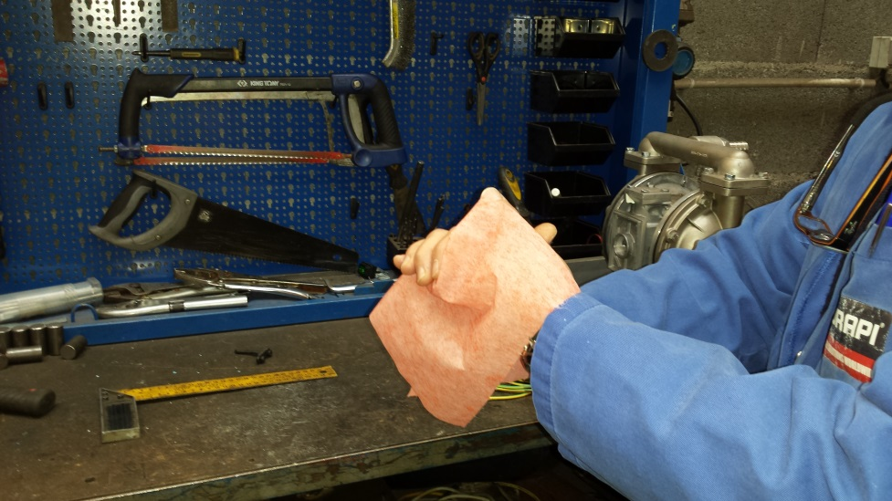
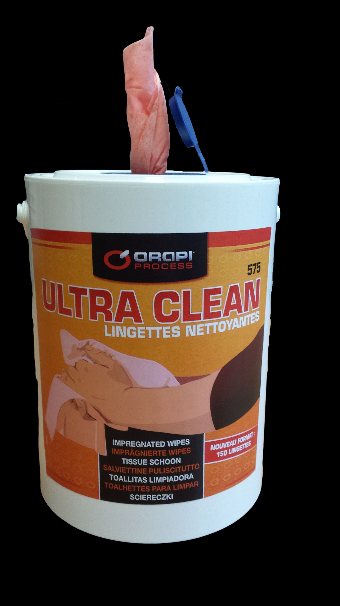
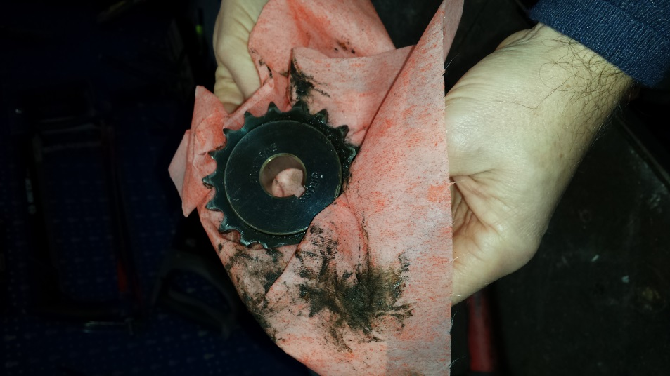
WIPES ULTRA CLEAN: HANDS and MECANICS
2

Slide 16
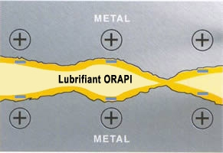
LUBRICANTS
3
Reduce friction
Reduce overheating
Reduce wear
Avoiding corrosion
Improving performance
Increase the lifetime of the mechanisms

Slide 17
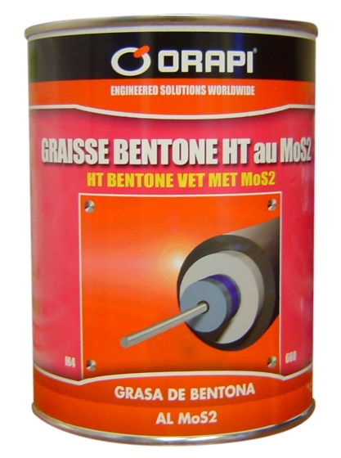
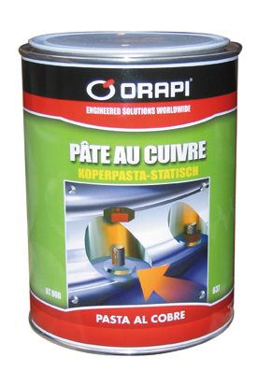
LUBRICANTS
3
DRY
OILS
GREASES
PASTES

Slide 18
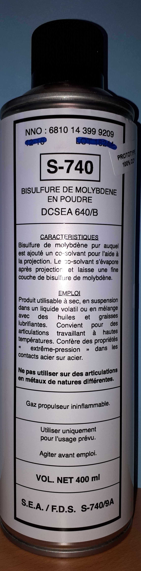
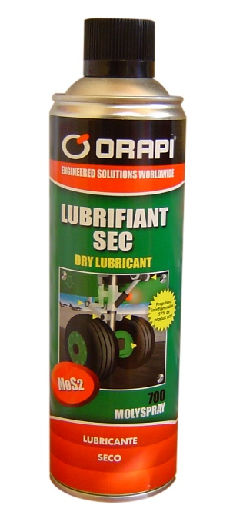
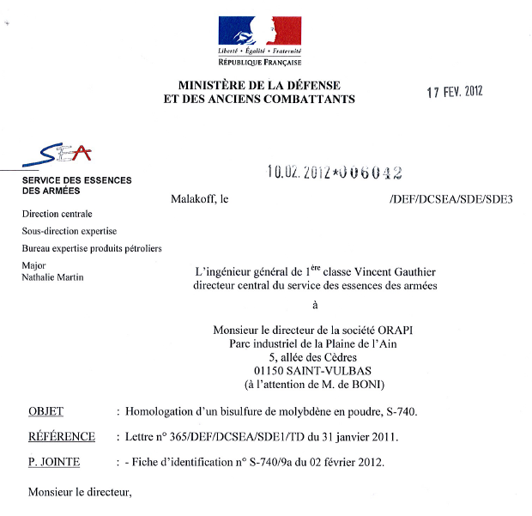
DRY LUBRICANTS
3
MOLYSPRAY 700
S-740

Slide 19
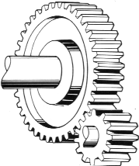
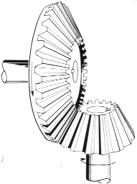
OILS FOR GEARS, HYDRAULICS, ….
4
FRENCH NATIONAL POTENTIAL
78 000 T - hydraulics
9 000 T - gears
20 000 T - oils for other mecanisms
TOTAL 107 000 T

Slide 20
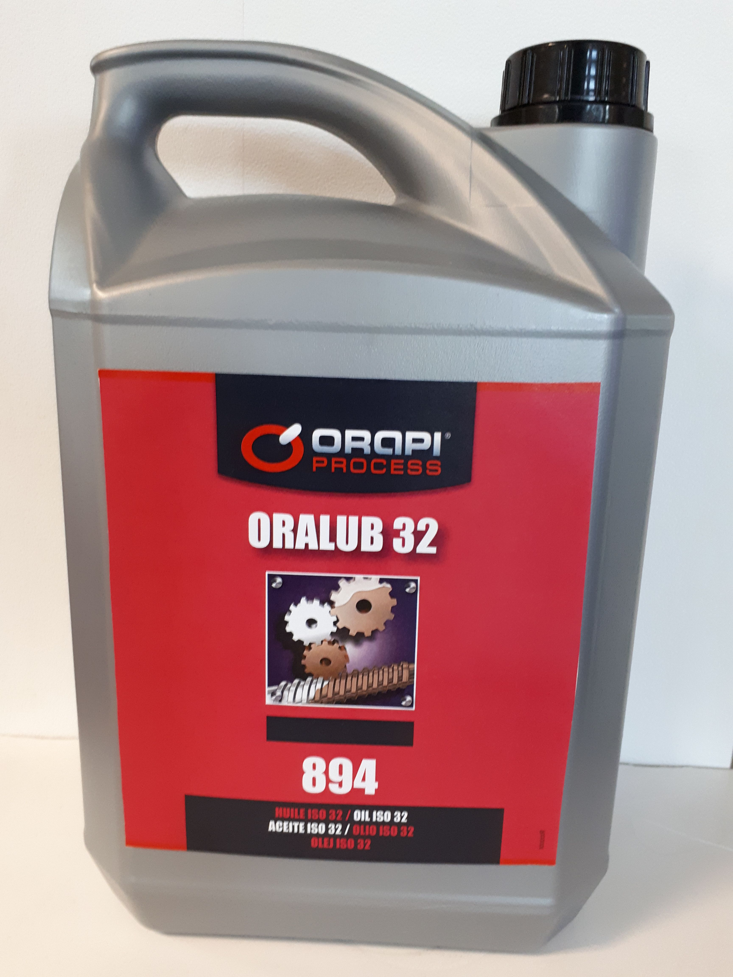
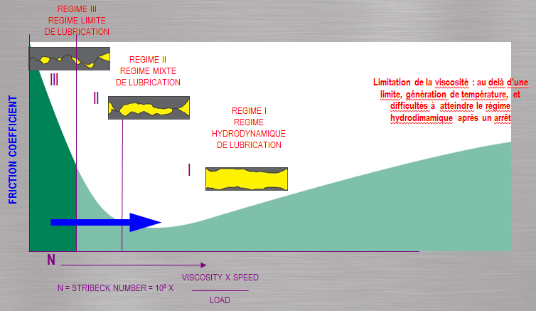
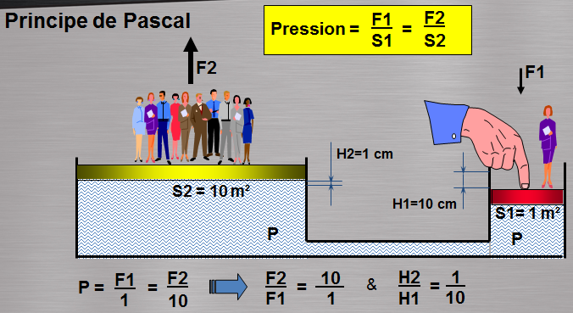
OILS FOR GEARS, HYDRAULICS, ….
4
COMPETITORS:
MOBIL YACCO UNILOPAL IGOL TOTAL Q8 BARDAHL KLUBER ENI CONDAT
MOLYDAL FUCHS FAG ESSO YORK CASTROL SHELL ……

Slide 21
GOOD PRICES
4
Désignation ORAPI | ref ORAPI | CDT de vente | cession | tarif 2018 | prix c / l | tarif 2017 | cession 2017 | prix c / l | baisse
ORALUB 32 | 2894J1 | 5 litres | 7,61 | 22,84 | 1,52 | 35,50 | 14,63 | 2,93 | 48%
 | 2894O1 | 20 litres | 28,35 | 85,05 | 1,42 | 127,81 | 65,74 | 3,29 | 57%
 | 2894U2 | 220 litres | 291,06 | 873,18 | 1,32 | 1195 (208 l) | 631,59 | 3,04 | 56%
ORALUB 46 | 2893J1 | 5 litres | 7,67 | 23,00 | 1,53 | 35,81 | 15,36
 | 2893O1 | 20 litres | 28,56 | 85,68 | 1,43
 | 2893U2 | 220 litres | 293,37 | 880,11 | 1,33 | 1247 (208 l) | 586,74 | 2,82 | 53%
ORALUB 68 | 2895J1 | 5 litres | 7,77 | 23,31 | 1,55 | 35,81 | 15,99 | 3,20 | 51%
 | 2895O1 | 20 litres | 28,98 | 86,94 | 1,45
 | 2895U2 | 220 litres | 297,99 | 893,97 | 1,35 | 1206 (208 l)
CB 831 | 2831J1 | 5 litres | 7,82 | 23,47 | 1,56 | 73,51 | 29,86 | 5,97 | 74%
 | 2831O1 | 20 litres | 29,19 | 87,57 | 1,46
 | 2831U2 | 220 litres | 300,30 | 900,90 | 1,37 | 2411 (208 l)
Example : Emmanuel D (customert: FIRE TRUCK maintenance)
Drum from SHELL = about 400 euros / drum.
Be carefull: 220 liters vs 208 liters = 6% more

Slide 22
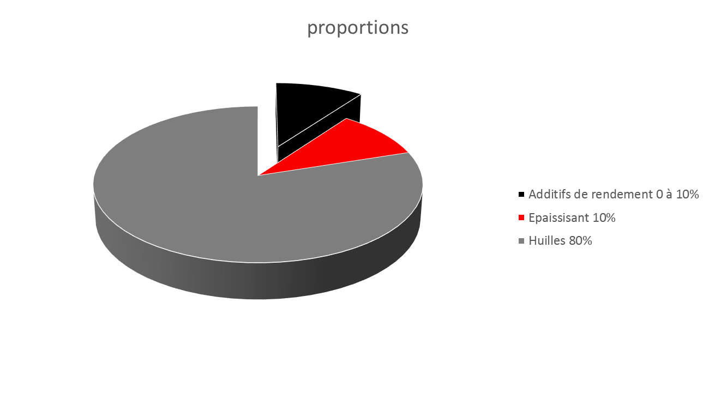
GREASES
3

Slide 23
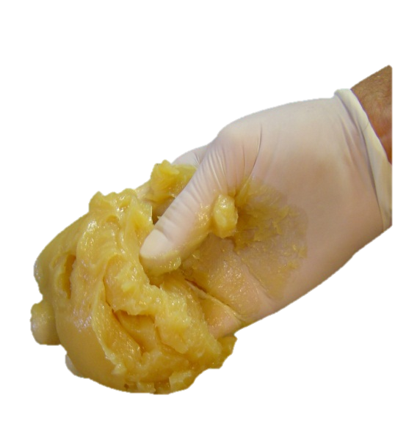
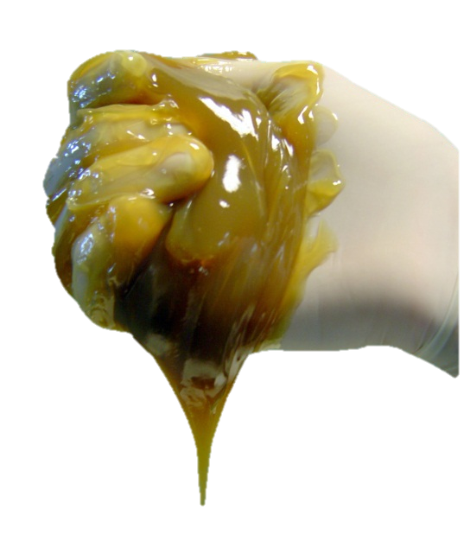
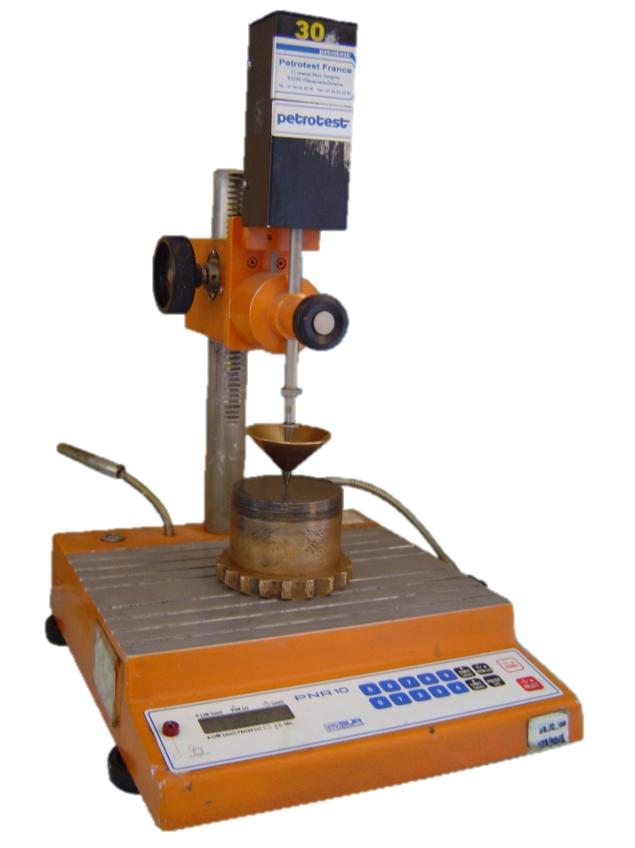
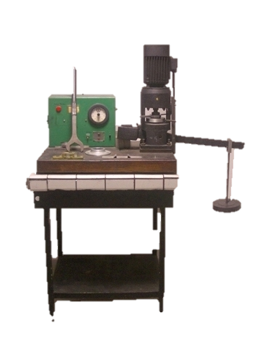
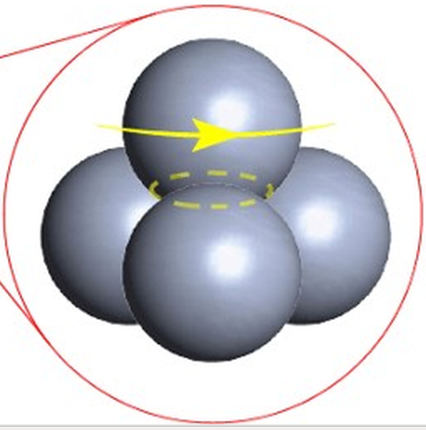
GREASES CARACTERISTICS
3
Soft grease
grade 0
Cold applications
Centralized lubrication
ANTIWEAR
Prevents the wear of moving surfaces
EXTREME PRESSURE
Increases the resistance of the lubricating film subjected to high loads
Narmal grease
grade 2
Hard grease
grade 3
sealant

Slide 24
GREASES - BEST SELLER
3
MULTI USED
LI-CA grade 0
ENG CB
GEARS
WATERPROOF
LITHIUM + MoS2
CALCIUM
LITHIUM
CT 4
CT 14
WSA
RUBBER
SI 4
SILICON

Slide 25
PASTES
3
STATIC APPLICATIONS
ANTI SEIZE
THERMO DRIVER
ELCTRO DRIVER

Slide 26
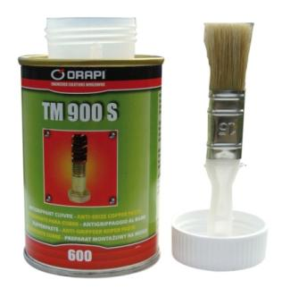
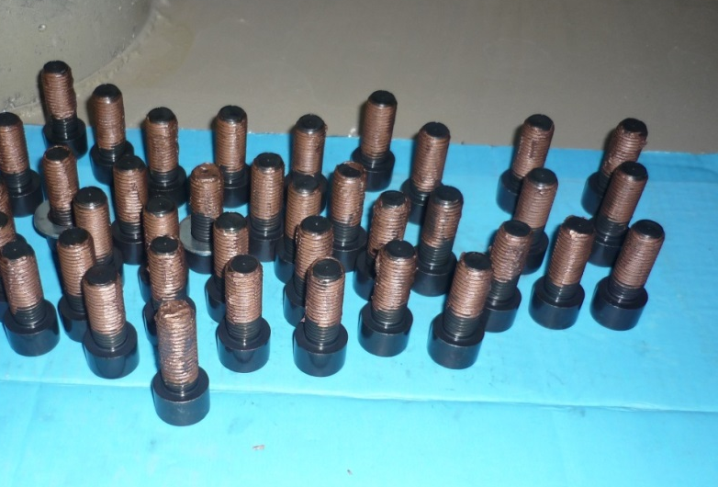
PASTES - BEST SELLER
3
COPPER
TM 900S
ALUMINIUM
HT 600

Slide 27
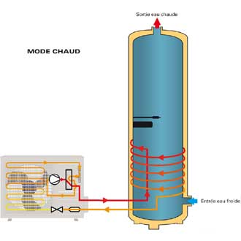
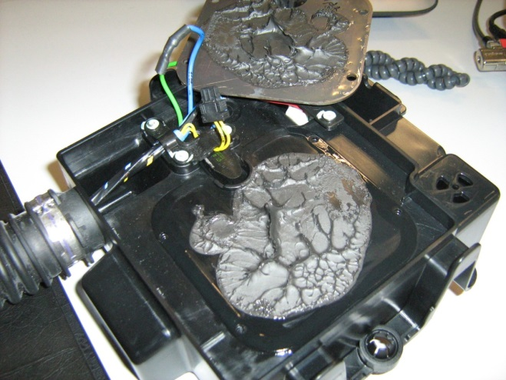

THERMO DRIVER
3
PATE THERMOCONDUCTRICE 6412 et 641
are used between 2 pieces to promote the transfer of calories

Slide 28






ASSEMBLE
4
CLEANERS
ANAEROBICS RESINS
GLUES
FLEXIBLE ADHESIVES
EPOXIES

Slide 29

ASSEMBLE
4
ALWAYS CLEAN BEFORE BONDING
OR ACTIVATE

Slide 30



LES RESINES ANAEROBIES
4
THREADLOCKER
RINGS and BEARINGS LOCKERS
THREAD SEALANT
FLANGE SEALS
FREINAGE MOYEN
FREINAGE FAIBLE
FREINAGE FORT
FIXPRESS
TUBELOCK EXTRA
PORAJOINT
Anaerobic resins are single-component products, that polymerise (harden) at an ambient temperature when there are not in contact with oxygen.
When the adhesive is protected against the oxygen of air during the assembly, and when there is simultaneous metallic contact (catalyser: Cu, Fe), the resin POLYMERISES rapidly.

Slide 31

LES GLUES
4
Cyanoacrylates are single-component adhesives, which cure at ambient temperature.
When the adhesive is in contact with two surfaces, the humidity in the air neutralises the stabilizing agent and induces curing.
These adhesives are used preferably for "zero gaps".
THE ACTIVATEUR 6140 permits a more rapid, polymerisation or to make polymerise the adhesive which has been left uncovered.
ADVANTAGES:
A little drop is sufficient.
VERY FAST bonding speed.
KEEP IN COOL PLACE.
Life time from 10 to 12 months in a cool place.
C 3000
C 2040

Slide 32




FLEXIBLE ADHESIVES
4
JOINT BLEU AUTO 102
ORABOND 125
ORABOND 129

Slide 33




EXAMPLE – COLLAGE PLATINES LINKY chez ENEDIS
4

Slide 34


2-COMPONENT ADHESIVES
4
OREPOX 5
ORAMETAL POCKET
ADHERLOCK 73

Slide 35


CORROSION PROTECTIO
5
OIL/WAX
PROTOR 842
WAX
PROTOR SG 100
VARNISH
VERTRO
LIGHT OIL
WR +
PEELABLE PROTECTION
PROTOR PL

Slide 36




CORROSION PROTECTION- GALVANISATION
5

